Slide 1
Employees Management Platform
Design, Implementation, and Evaluation of a Django REST API
https://caoyuchen688.pythonanywhere.com/
Author: CAO Yuchen SWJTU ID: 2022115980 Leeds ID: 201690931
Django
SQLite
REST API
2024 – 2025 Academic Year

Slide 2
Project Overview & Objectives
Data & Storage
API Design
Security
SQL-backed employee management
SQLite database
Structured data model
RESTful CRUD operations
Consistent JSON responses
Proper HTTP status codes
Authenticated write actions
Token-based auth
IsAuthenticatedOrReadOnly
Frontend Interface
Documentation
Testing
Browser-based demo UI
HTML + Bootstrap
Consumes the same API
Endpoint reference
Design decisions
Testing evidence
8 automated tests
Management command tests
Live demo evidence

Slide 3
Architecture & Technology Stack
Presentation Layer
Why This Stack?
HTML · CSS · JavaScript · Bootstrap
01
Rapid Development
Django's batteries-included approach minimises boilerplate
Application / API Layer
Django + Django REST Framework
Maintainability
02
DRF serialisers and class-based views keep code organised
Data Layer
SQLite Database
03
Lightweight Deployment
SQLite requires zero server setup for local coursework

Slide 4
Data Model & Key Design Decisions
Employee Model
id
AutoField (PK)
emp_id
CharField (unique)
Lookup Order
export_id
CharField (unique)
Requests resolve first by id → export_id → emp_id, ensuring flexible client queries.
first_name
CharField
last_name
CharField
email
EmailField (unique)
department
CharField
Unique Constraints
job_title
CharField
emp_id and email both carry DB-level UNIQUE constraints to enforce data integrity.
created_at
DateTimeField (auto)
updated_at
DateTimeField (auto)

Slide 5
API Endpoints & Functional Scope
Authentication
Extended Endpoints
POST
/api/auth/register/
Register a new user
GET
/api/employees/search/
Search employees
POST
/api/auth/
Obtain auth token
GET
/api/employees/stats/
Department statistics
Employee CRUD
GET
/api/info/
GET
/api/employees/
List all employees
API route discovery
POST
/api/employees/
Create employee
GET
/api/employees/{id}/
Retrieve employee
PUT
/api/employees/{id}/
Full update
PATCH
/api/employees/{id}/
Partial update
DELETE
/api/employees/{id}/
Delete employee

Slide 6
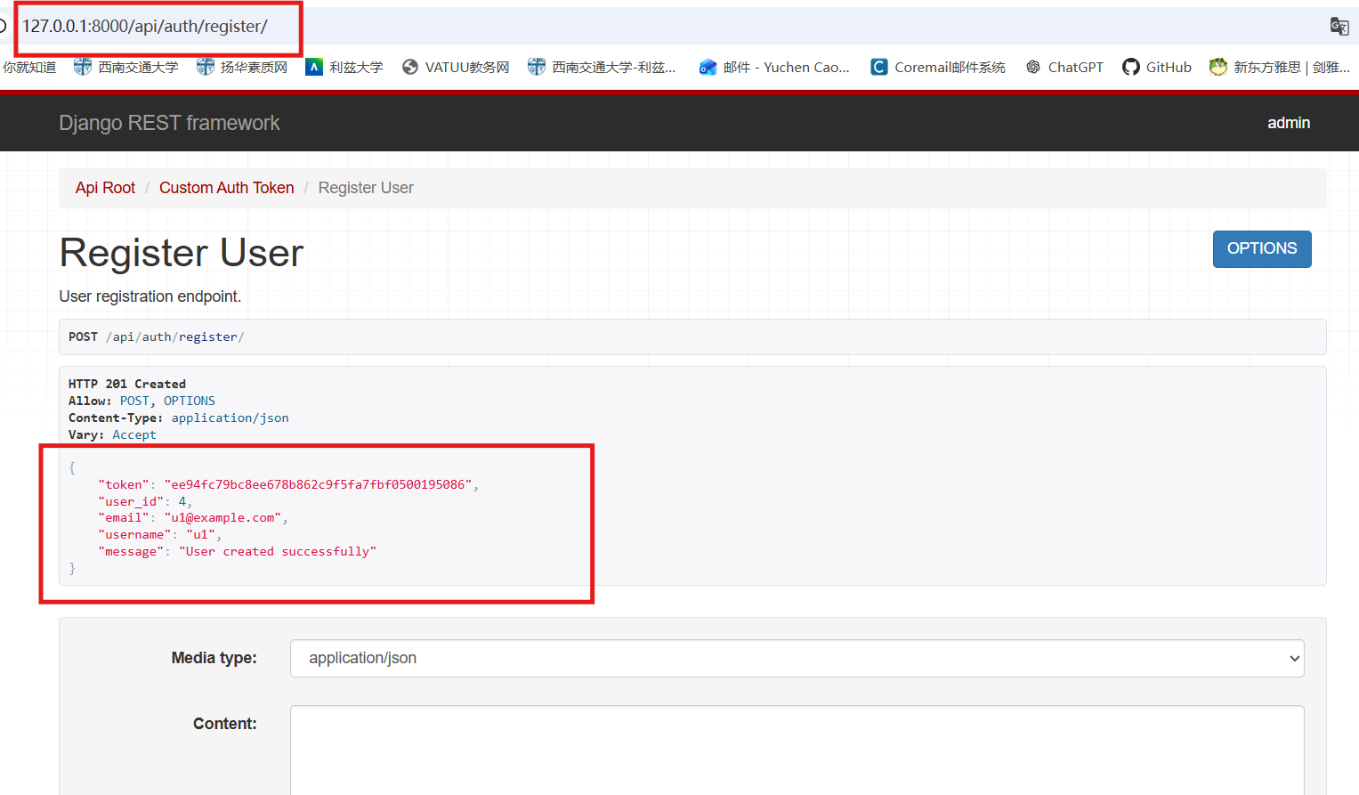
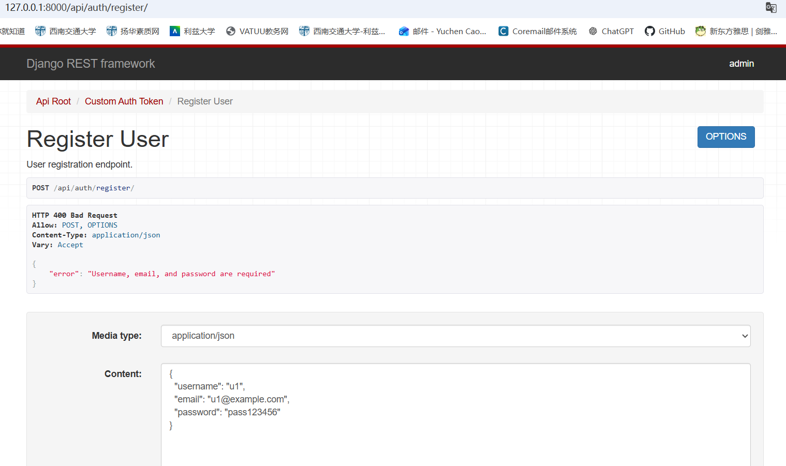
API Endpoints & Functional Scope
Authentication
POST
/api/auth/register/
Register a new user
POST

Slide 7
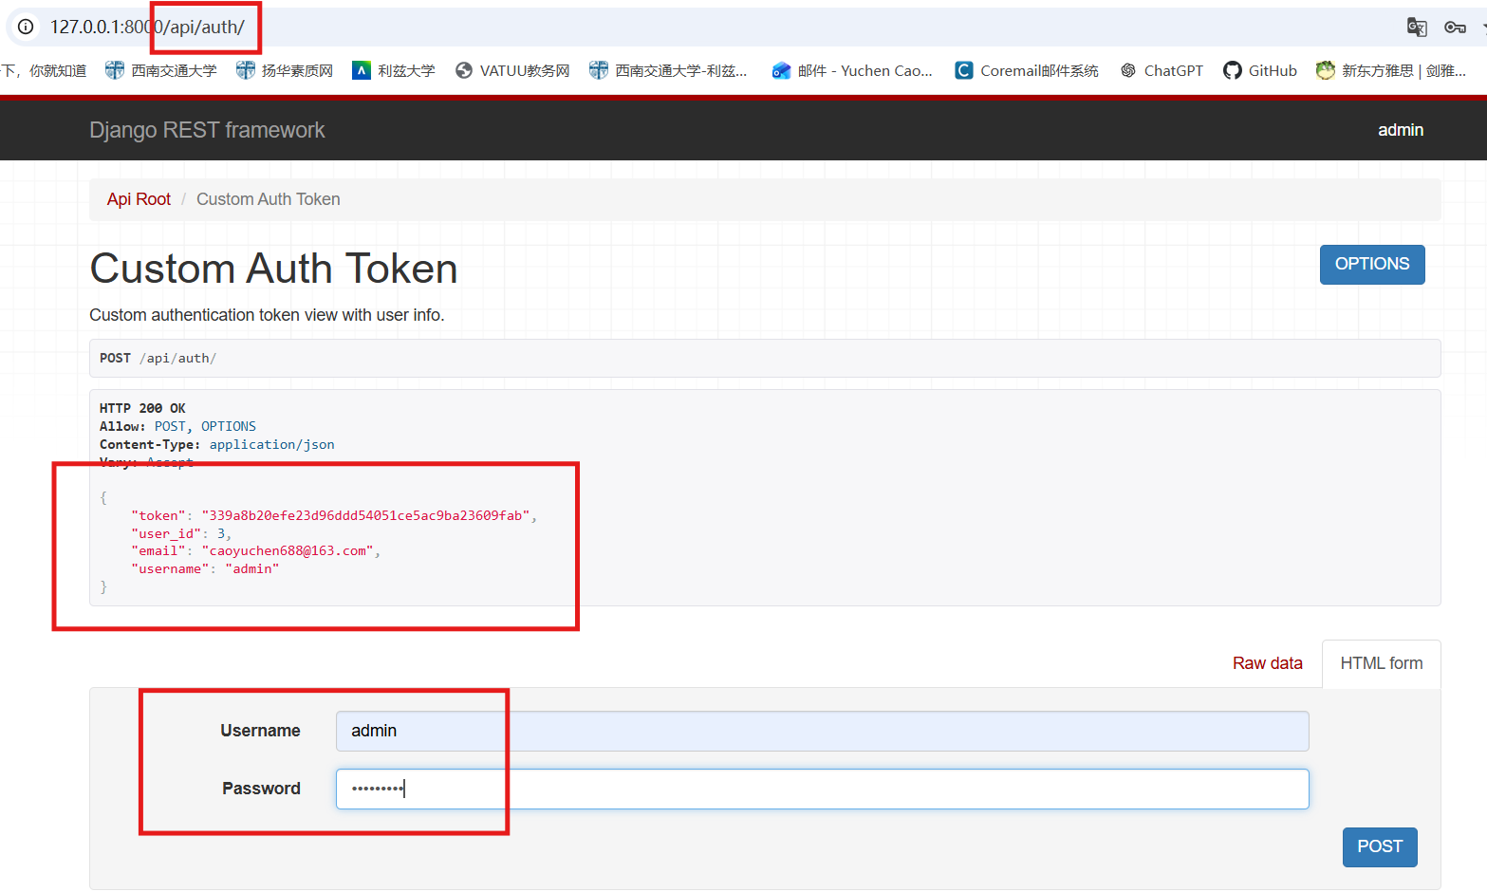
API Endpoints & Functional Scope
Authentication
Authentication
POST
POST
/api/auth/
POST
Obtain auth token
POST

Slide 8
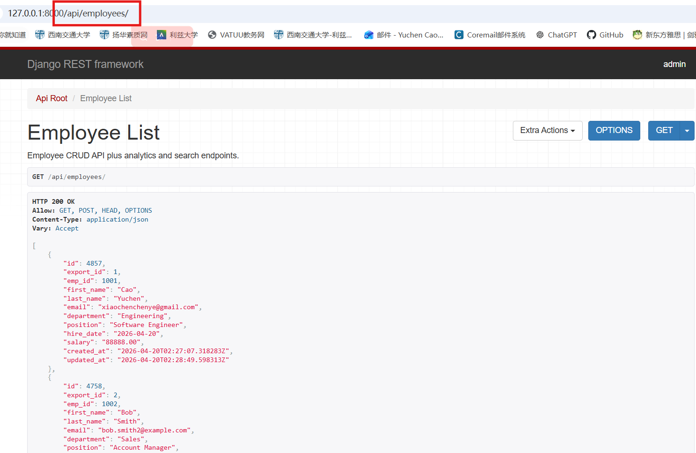
API Endpoints & Functional Scope
Employee CRUD
Authentication
GET
/api/employees/
List all employees

Slide 9
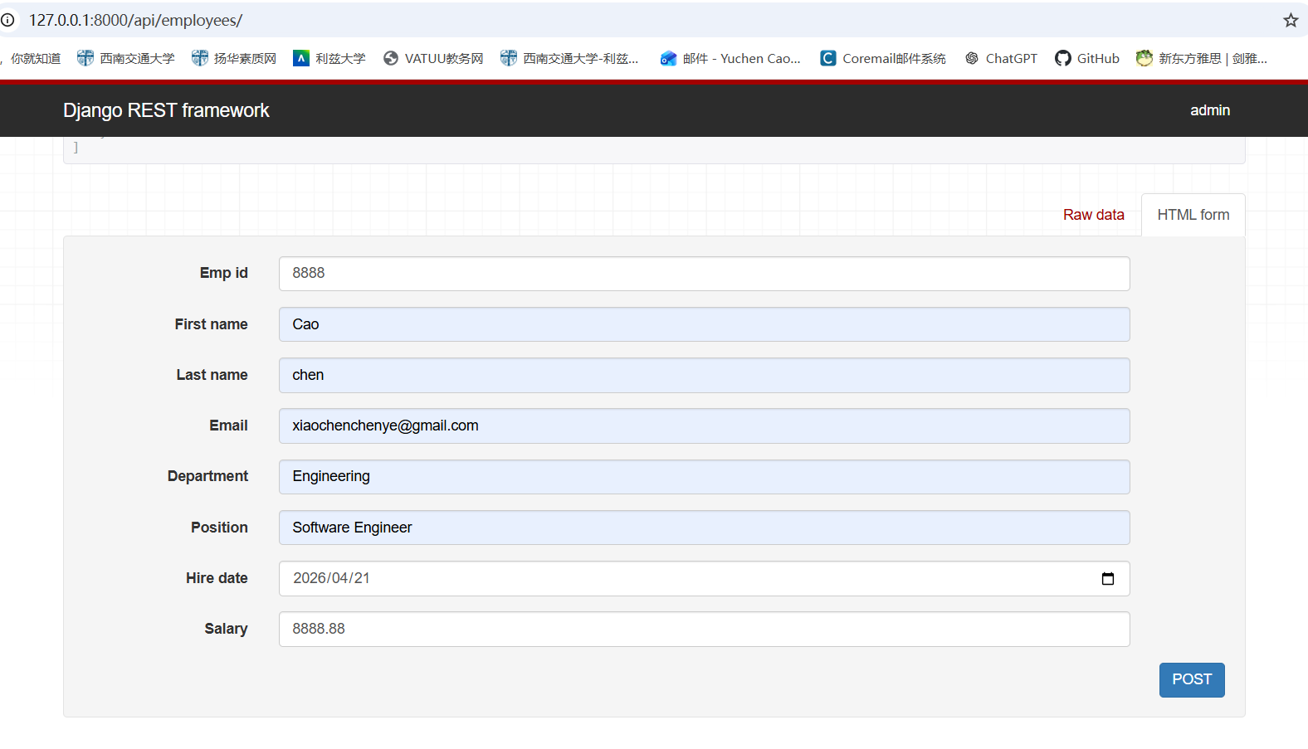
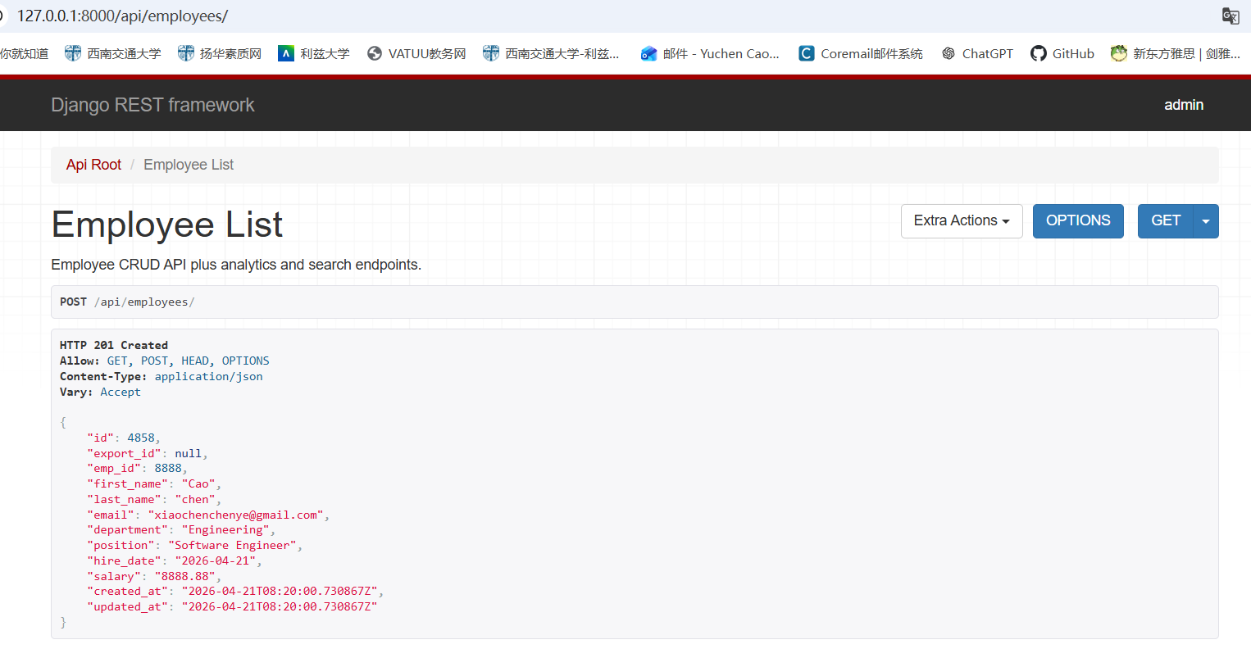
API Endpoints & Functional Scope
Employee CRUD
Authentication
POST
GET
/api/employees/
Create employee

Slide 10
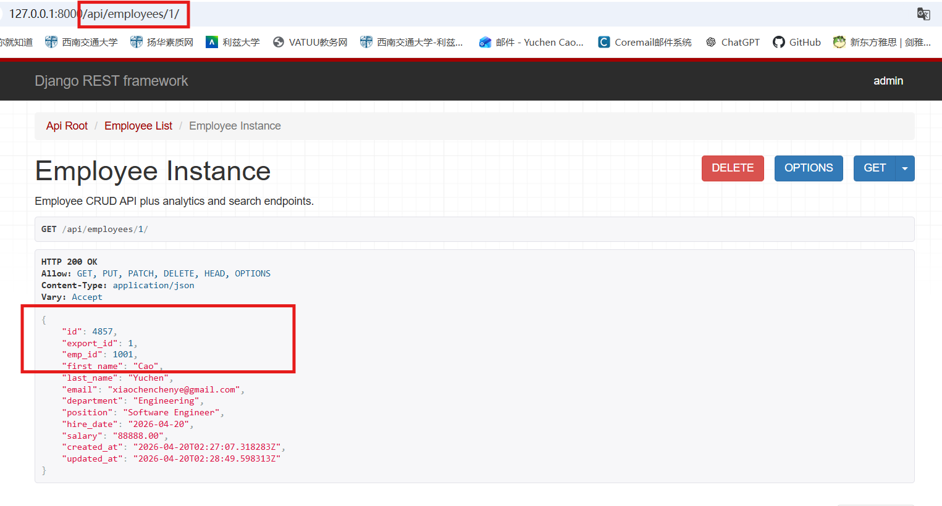
API Endpoints & Functional Scope
Employee CRUD
Authentication
GET
/api/employees/{id}/
Retrieve employee

Slide 11
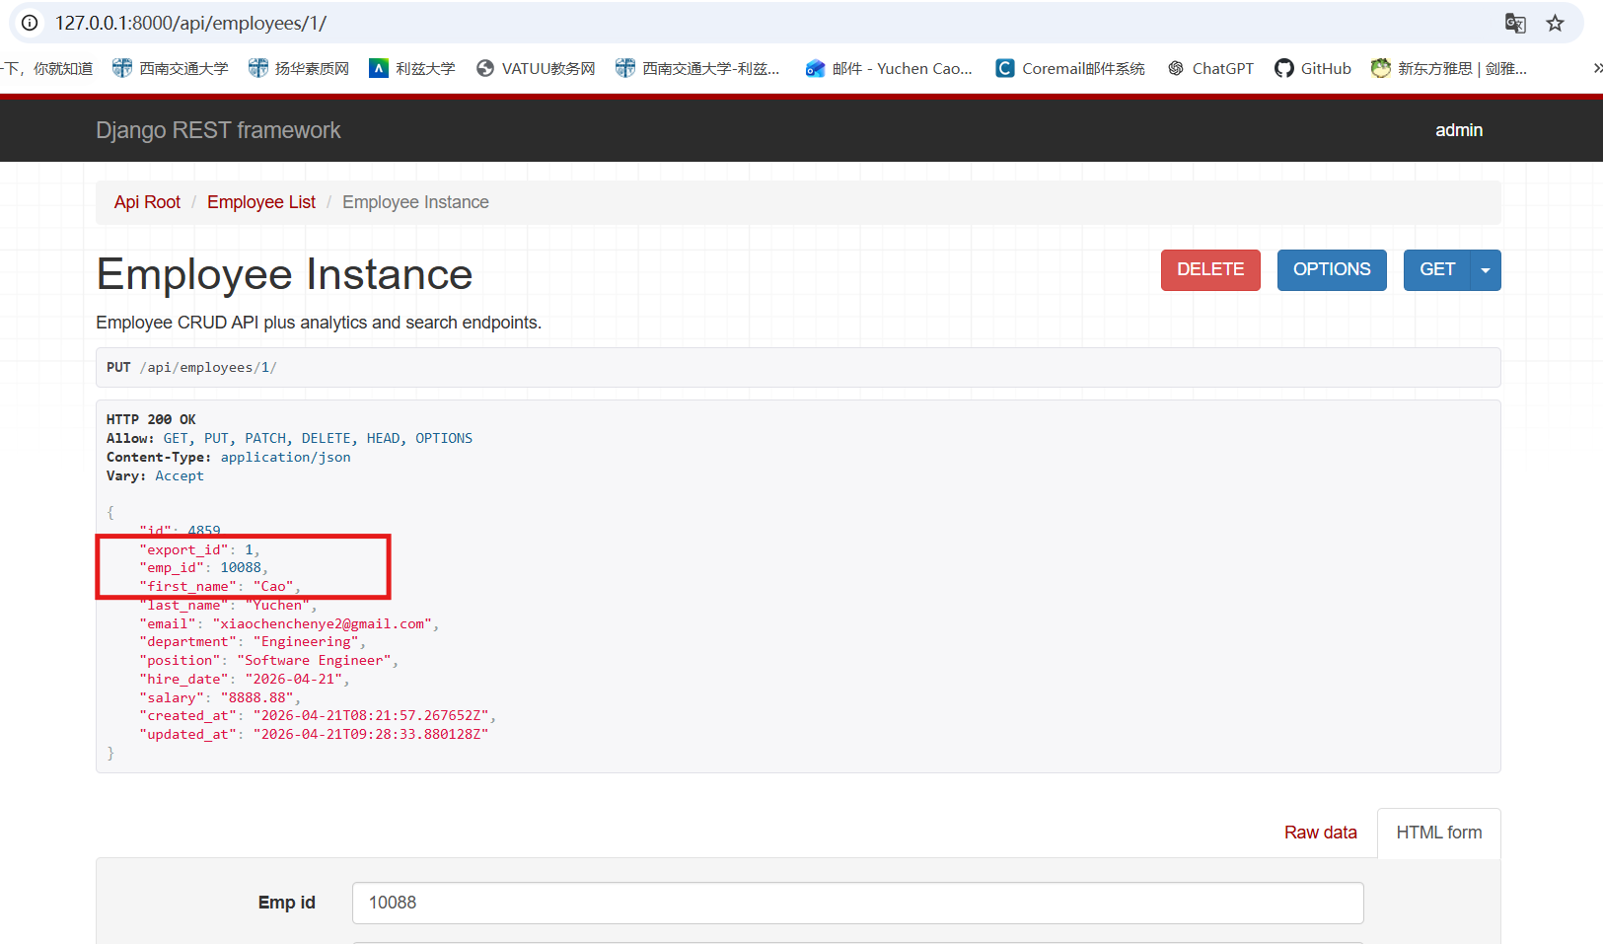
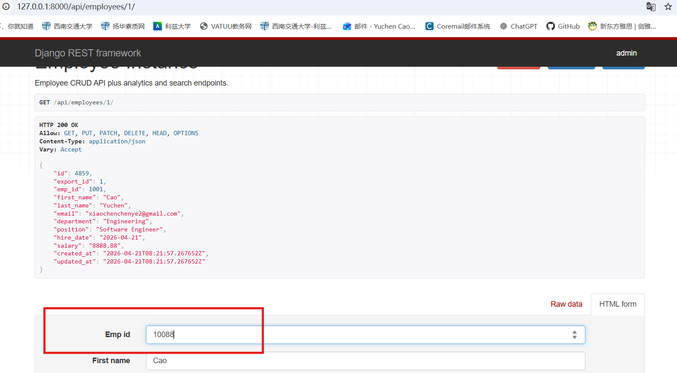
API Endpoints & Functional Scope
Employee CRUD
Authentication
PATCH
/api/employees/{id}/
Partial update

Slide 12
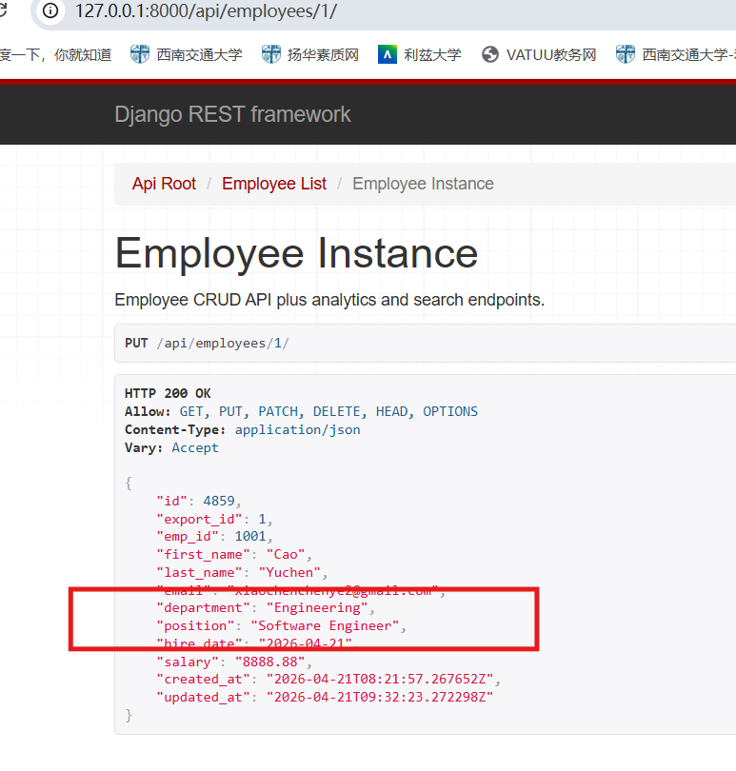
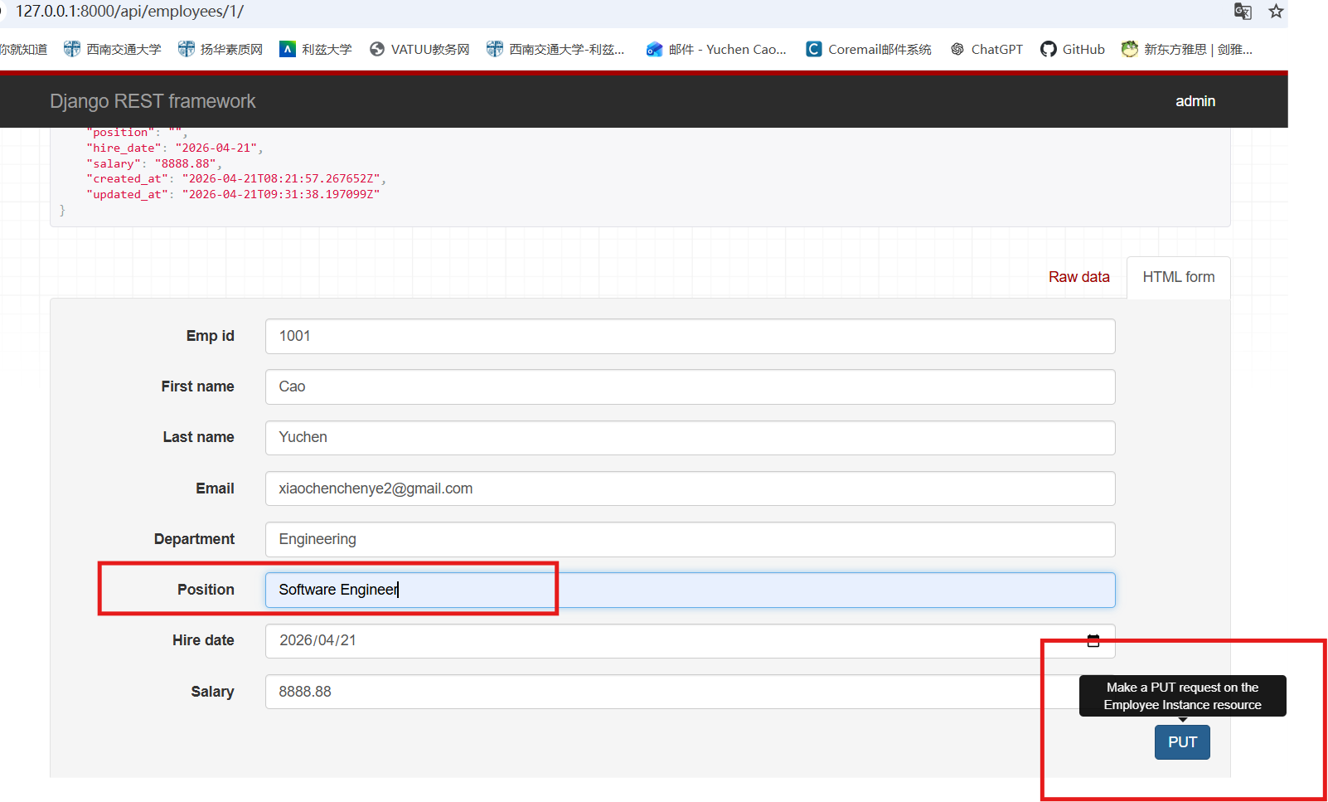
API Endpoints & Functional Scope
Employee CRUD
Authentication
GET
PUT
/api/employees/{id}/
Full update

Slide 13
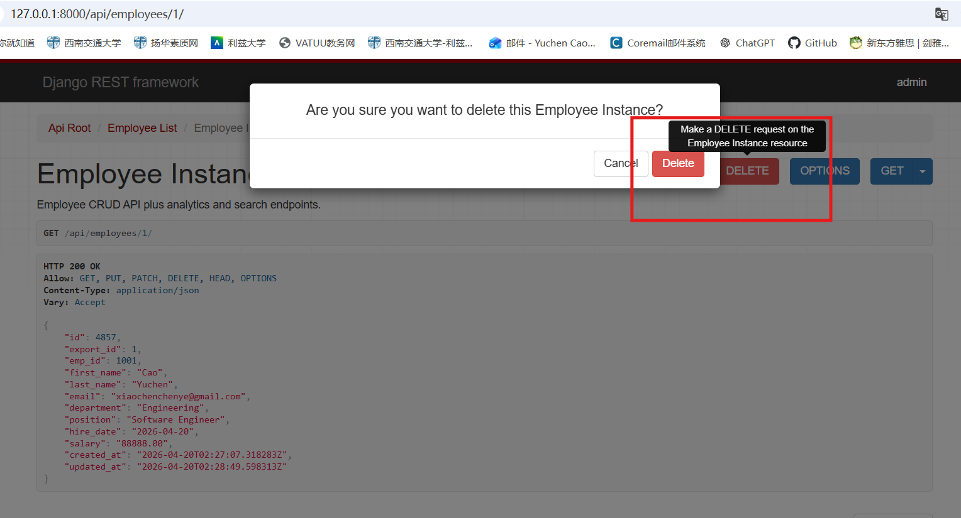
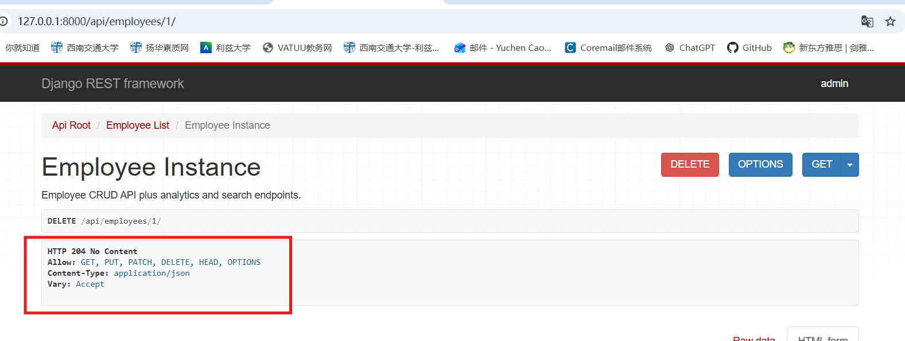
API Endpoints & Functional Scope
Employee CRUD
Authentication
DELETE
/api/employees/{id}/
Delete employee

Slide 14
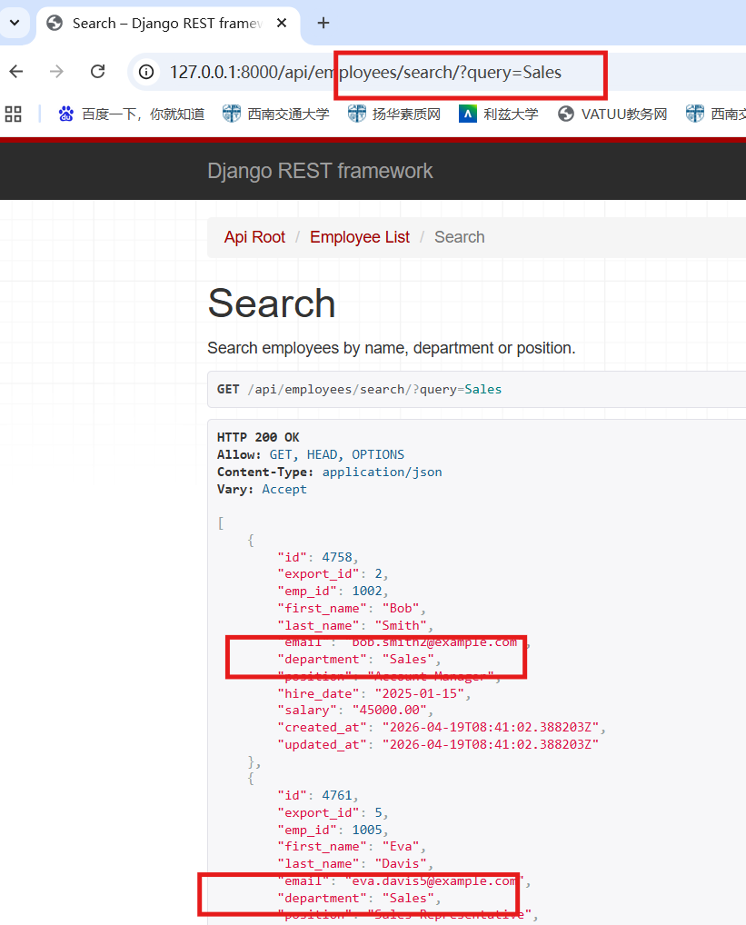
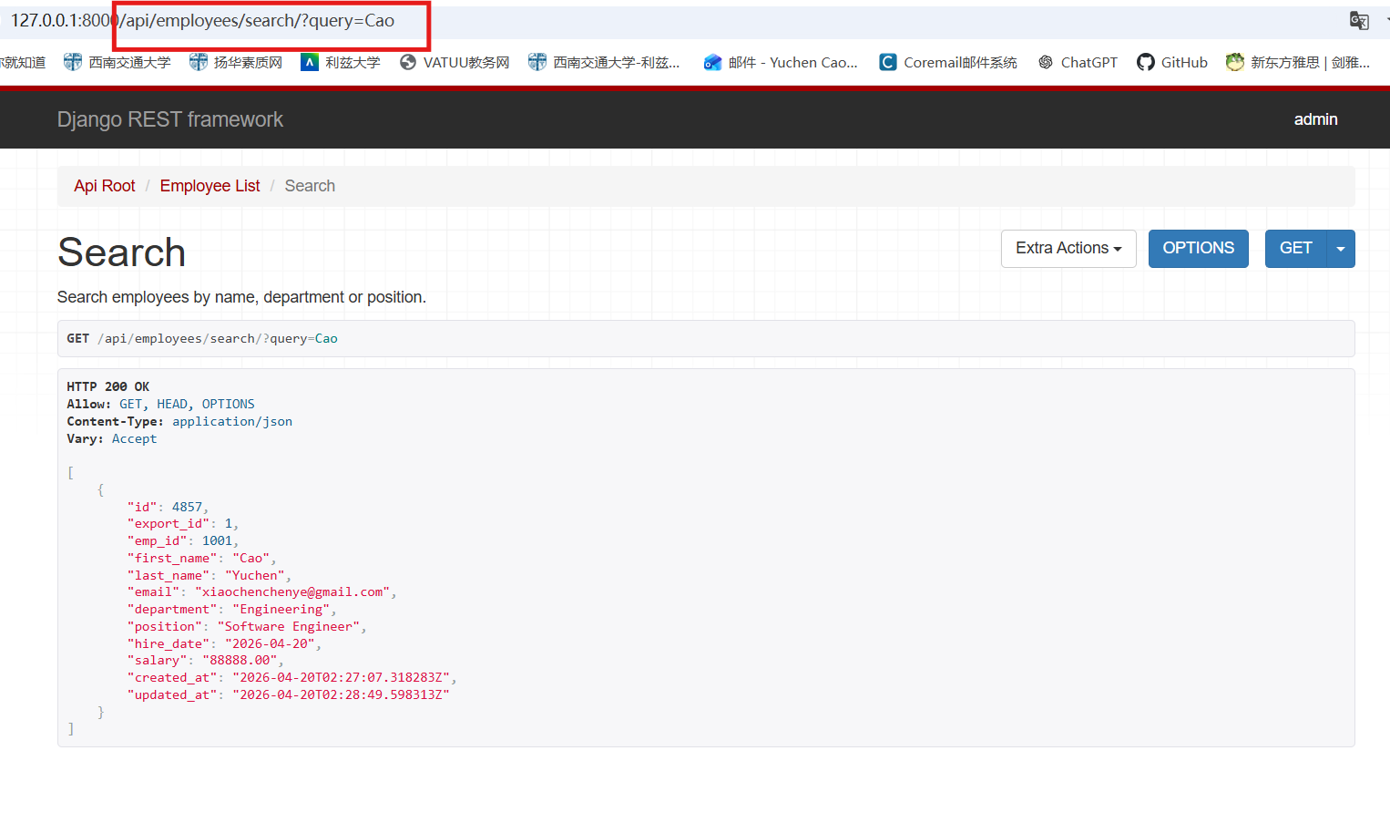
API Endpoints & Functional Scope
Extended Endpoints
GET
/api/employees/search/
Search employees
GT
GET

Slide 15
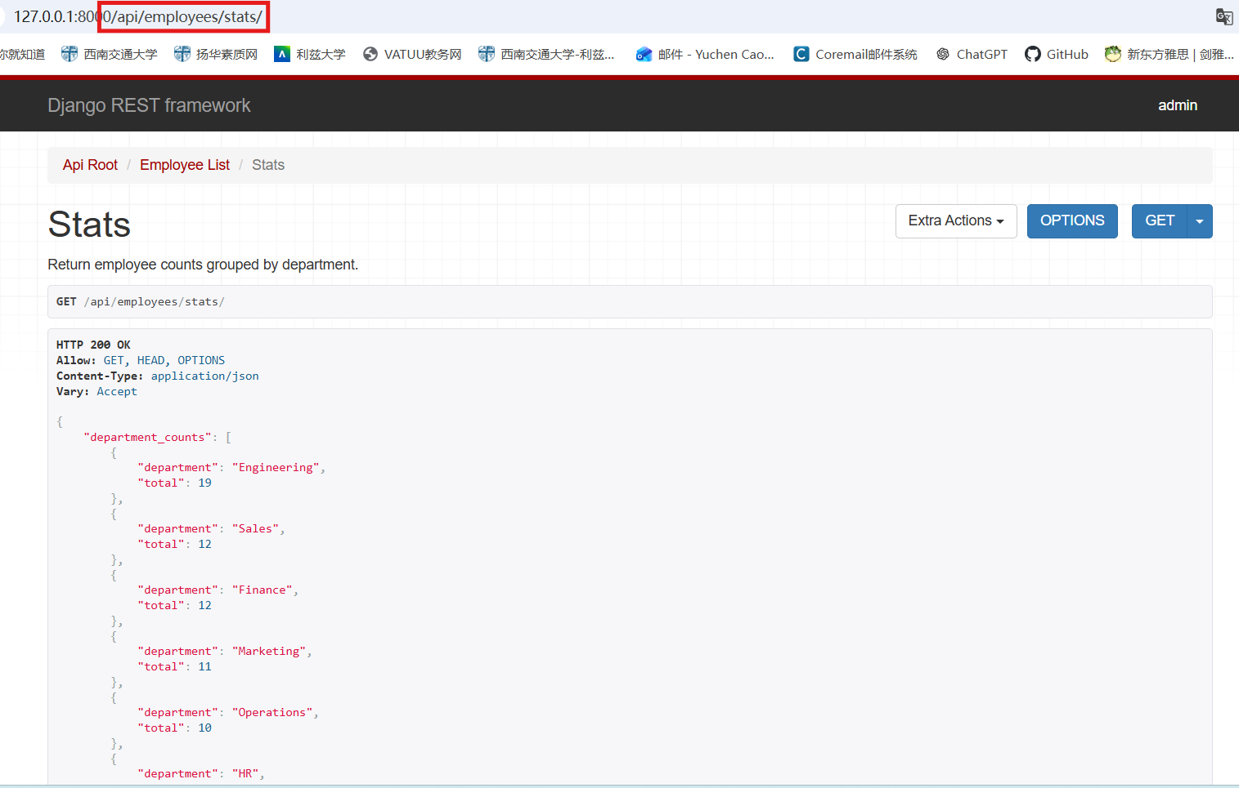
API Endpoints & Functional Scope
Extended Endpoints
GET
/api/employees/stats/
GET
Department statistics
GET

Slide 16
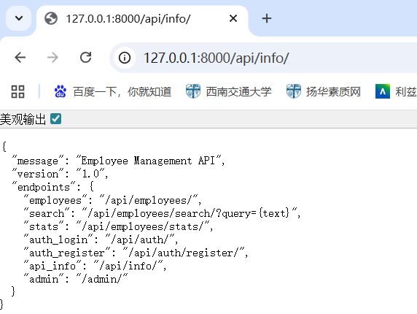
API Endpoints & Functional Scope
Extended Endpoints
GET
/api/info/
API route discovery

Slide 17
Authentication, Permissions & Security
Global Permission Class: IsAuthenticatedOrReadOnly
01
Public Read
Anyone may call GET endpoints without a token.
Employee data is read-only publicly.
02
Authenticated Write
POST / PUT / PATCH / DELETE require a valid token.
Unauthorised attempts return 401.
03
Token Workflow
1. POST /api/auth/register/ → create user
2. POST /api/auth/ → receive token
3. Send token in Authorization header

Slide 18
Error Handling & Response Semantics
200
Successful GET / PUT / PATCH
400
Validation errors / missing fields
OK
Bad Request
201
Successful POST (employee created)
401
Missing or invalid token
Created
Unauthorised
204
Successful DELETE
404
Employee ID does not exist
No Content
Not Found

Slide 19
Dataset Import Workflow
python manage.py import_employees data.json [--dry-run] [--clear --yes]
01
Not a Public HTTP Endpoint
02
--dry-run Flag
03
--clear --yes Flag
Implemented as a Django management command — not exposed over HTTP. Prevents unauthorised bulk imports in production.
Simulates the import without committing to the database. Lets developers validate data integrity before a real load.
Wipes existing employee records before re-import. Useful for full dataset refreshes during development.
04
export_id Mapping
05
update_or_create Strategy
06
Repeatable Loading
The JSON id field is stored as export_id, preserving the original identifier separately from Django's auto-incremented PK.
Keyed on emp_id — re-running the command updates existing records rather than duplicating them.
Idempotent design means the command can be run multiple times safely, supporting CI workflows and test fixtures.

Slide 20
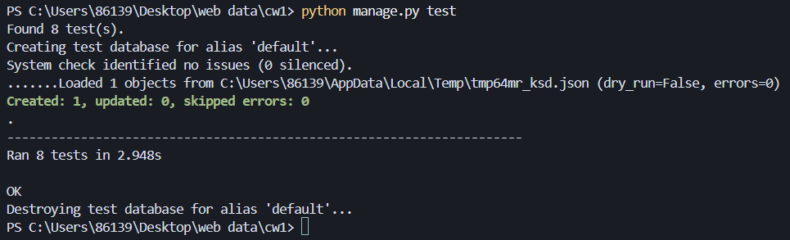
Automated Testing Evidence
PASS python manage.py test -- 8 / 8 Tests Passed

Slide 21
Validation / Error Cases & Discussion
Case 1 — Registration Error
Case 2 — Missing Search Query
Request:
Request:
POST /api/auth/register/
{ "username": "" }
GET /api/employees/search/
(no ?q= parameter provided)
Response (400 Bad Request):
Response (400 Bad Request):
{
"username": ["This field may not be blank."],
"email": ["This field is required."],
"password": ["This field is required."]
}
{
"error": "Search query parameter 'q' is required."
}
These cases confirm: (1) validation is enforced server-side, (2) error messages are clear and actionable, (3) implementation matches the documented API contract.

Slide 22
Thanks For Listening!
Author: CAO Yuchen SWJTU ID: 2022115980 Leeds ID: 201690931

